Slide 1
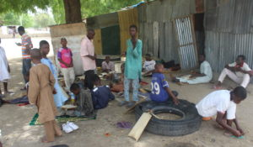
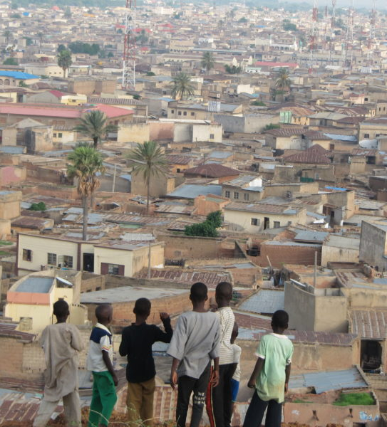
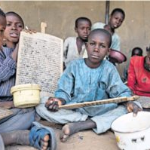
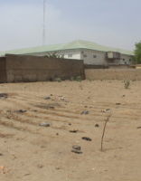
Northern Nigeria Children's Garden
Global Roots: Project Launch Plan

Slide 2
NORTHERN NIGERIA CHILDREN’S GARDEN
Phase 1 Collect Baseline Data
Phase 2 Program Pre-Planning
Phase 3 Program Implementation
Phase 4 Continuation of Operations
Use Global Roots data tools to collect initial student and teacher data (3 - 5 days):
Name, age, and gender.
Begging frequency.
Time given for formal education, if applicable.
Level of formal education, if applicable.
Number of square meals per day.
Interest in formal education.
Type of vocation and income generated.
Form of humanitarian support, if any.
Enlist support from parents.
Recruitment and boarding of gardener. (3-5 days)
Land clearing and preparation:
Install fencing.
Build chicken pens.
Drill 45m borehole adapting Global Roots standards to the local practice. (10 – 15 days)
Chicken coup planning and purchasing: (1-3 days)
Chicks
Chicken feed
Feeders
Drinkers
Farm tools
Seedlings
Planting and cultivation of crops. (2-4 days)
Confirm farm operations and logistics.
After two weeks: Bring in second group of chicks.
After four weeks: Bring in third group of chicks.
After six weeks:
Build first chicken coup.
Sell 30 – 40% of chickens.
Bring in new group of chicks.
After eight weeks:
Build second chicken coup.
Sell 30 – 40% of chickens.
Sell first garden crop.
Bring in new group of chicks.
Complete training of students and teachers on gardening and poultry farming.
After ten weeks:
Build third chicken coup.
Sell 40% of chickens.
Sell current garden crop.
Bring in new group of chicks.
Continue cycle of building new chicken coup and bringing in new chicks every two weeks.

Slide 3
Project Launch Estimates – Month 1
Expense Type | Description | Estimated Price / Unit | Quantity | Unit | Estimated Total Price / Unit | Total Price (USD)
One-Time | Power generator (2KVA) | NGN 100,000.00 | 1 | Pcs | NGN 100,000.00 | $279.51
One-Time | Water Borehole (45 - 60m deep) | NGN 250,000.00 | 1 | Pcs | NGN 250,000.00 | $698.77
One-Time | Perimeter wire fence installation | NGN 1,000.00 | 110 | Bundles | NGN 110,000.00 | $307.46
One-Time | Data collection and entry | NGN 5,000.00 | 3 | Persons | NGN 15,000.00 | $41.93
Periodic | Farm implements (Hoes, shovels, diggers) | NGN 1,000.00 | 10 | Pcs | NGN 10,000.00 | $27.95
Periodic | Chicken feeders | NGN 1,000.00 | 8 | Pcs | NGN 8,000.00 | $22.36
Periodic | Chicken drinkers | NGN 1,000.00 | 8 | Pcs | NGN 8,000.00 | $22.36
Periodic | Cooking utensils and ingredients | NGN 1,000.00 | 10 | Pcs | NGN 10,000.00 | $27.95
Recurring | Logistics and admin | NGN 50,000.00 | 1 | Month | NGN 50,000.00 | $139.75
Recurring | Gardener | NGN 70,000.00 | 1 | Month | NGN 70,000.00 | $195.66
Recurring | Generator fuelling and maintenance | NGN 10,000.00 | 1 | Month | NGN 10,000.00 | $27.95
Recurring | Unvaccinated day old broiler chicks | NGN 350.00 | 150 | Pcs | NGN 52,500.00 | $146.74
Recurring | Vaccine (Two rounds) | NGN 50.00 | 40 | vials | NGN 2,000.00 | $5.59
Recurring | Chicken feed | NGN 3,900.00 | 27 | Bags | NGN 105,300.00 | $294.32
Recurring | Chicken house | NGN 85,000.00 | 1 | Pcs | NGN 85,000.00 | $237.58
Recurring | Seedlings | NGN 1,500.00 | 3 | Bags | NGN 4,500.00 | $12.58
 |  |  |  | TOTAL: | NGN 890,300.00 | $2,488.46

Slide 4
Project Launch Expense Breakdown

Slide 5
Project Launch Expense Breakdown by Type

Slide 6
Project Launch Expense Breakdown by %

